Slide 1
Logit and Regularization
Jacob LaRiviere
(some content from Justin Rao and Brian Quistorff)

Slide 2
Outline
Classes of explanatory Variables
Logit
Bias-Variance Revisited
Regularization
LASSO

Slide 3
Outcome types
Binary outcomes: equal to 1 or 0. Examples: coin is heads or tails, person is guilty or innocent, default or not on a loan, etc.
Continuous outcomes: can take an real value
Categorical outcomes: can take one of N qualitative values. Example: mapping symptons to a well-defined disease, favorite sports team, etc.
Traditional regression we’ve done is designed for continuous outcomes.
We can use classification for binary and categorical as outcomes in addition to features!

Slide 4
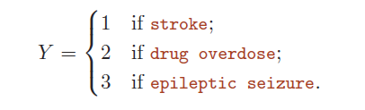
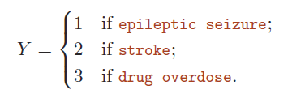
Why not linear regression?
A mapping of categories to numbers comes with strong implications
Would imply different “differences” across qualitative conditions
Vs.

Slide 5
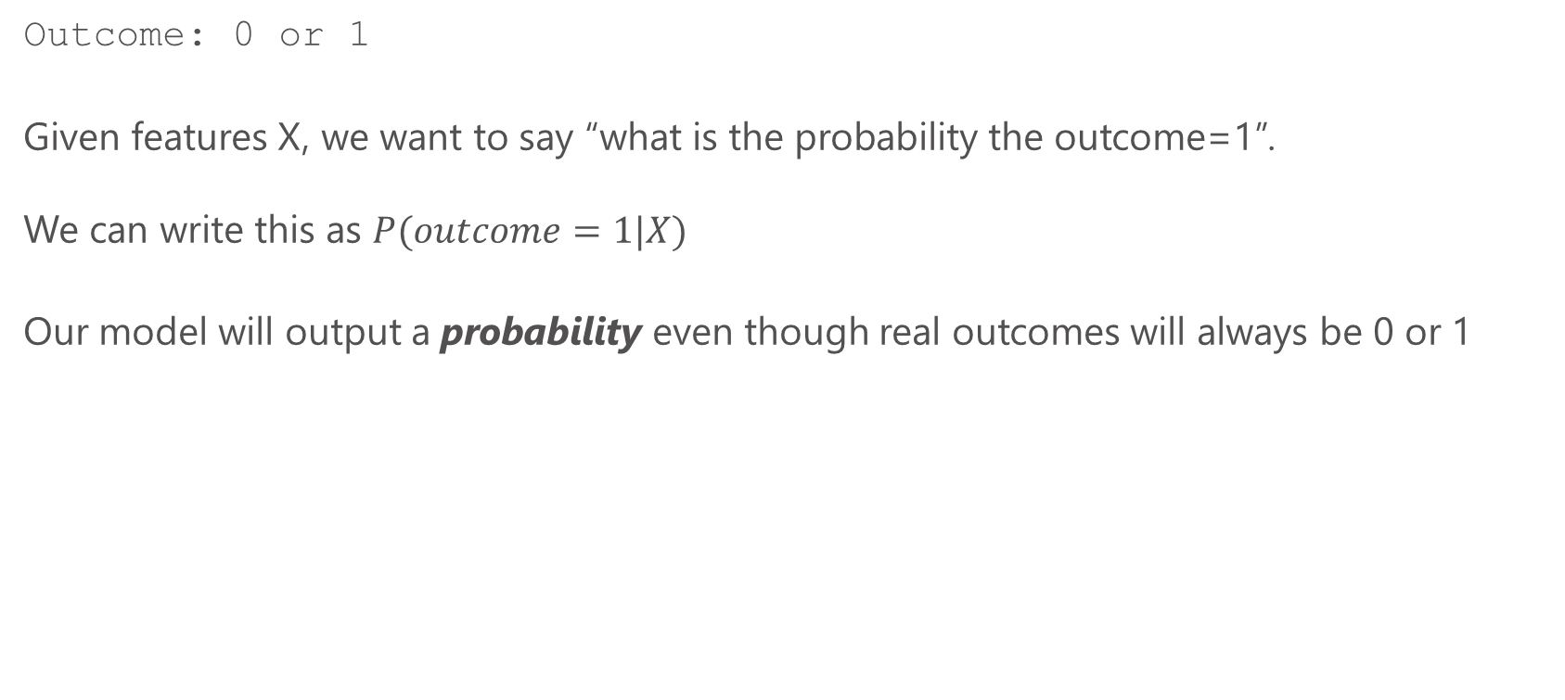
Classification with binary outcomes
Outcome: 0 or 1
Given features X, we want to say “what is the probability the outcome=1”.
We can write this as $P(outcome=1|X)$
Our model will output a probability even though real outcomes will always be 0 or 1

Slide 6
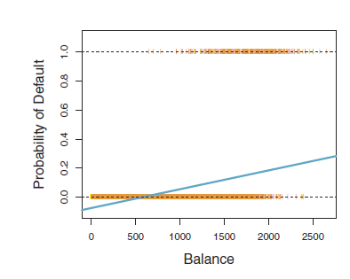
Linear models and probabilities
Linear models will tend to make predictions outside [0,1]
Since probabilities should never be outside [0,1], this is a bad feature
We will instead use non-linear models

Slide 7
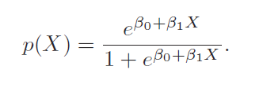
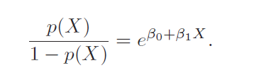
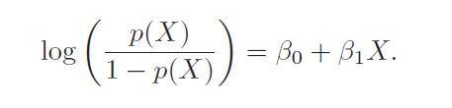
Logistic regression
Odds: ratio of probability outcome=1 to probability outcome=0
Examples
p(x)=.5. Odds=1 (or 1:1)
p(x)=.75. Odds=3 (or 3:1)
p(x)=.9. Odds=9 (or 9:1)
Logit says: the log of the odds is a linear function of the features.
Just like with regular regression, we can add more features

Slide 8
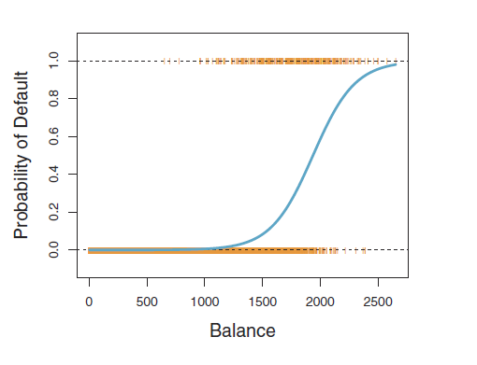
Visualizing a logistic function
The estimate parameters will make the function steeper or flatter (stretch it out) or shift it left or right
Estimation will minimized squared loss

Slide 9
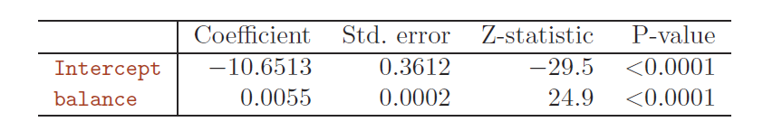
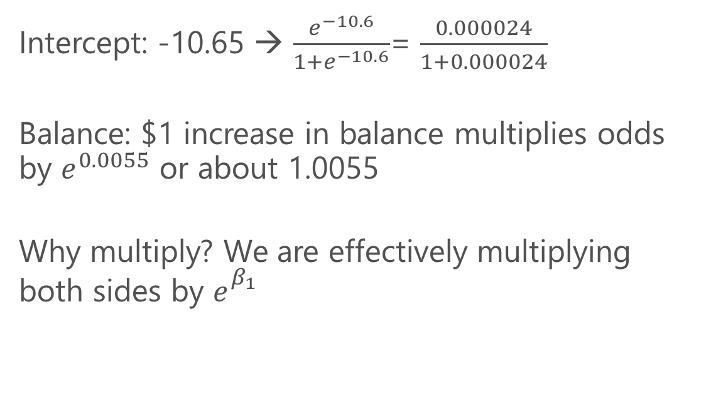
Logistic regression output
Intercept: -10.65 → $\frac{e^{−10.6}}{1+e^{−10.6}}$= $\frac{0.000024}{1+0.000024}$
Balance: $1 increase in balance multiplies odds by $e^{0.0055}$ or about 1.0055
Why multiply? We are effectively multiplying both sides by $e_{}^{β_{1}}$

Slide 10
Non-linear response
Increases in balance at the sat the start have a limited impact.
Similarly at the end.
In the middle region, increase are particularly important

Slide 11
Logistic regression in R
We will use the glm() function. “Generalized linear models”. family=binomial specifies Logit
predict(my_model, type=“response”) will output the fitted probabilities
To convert this to a 0,1 prediction, we simply set a threshold of when we want to predict 1 (0.5 will minimize prediction error)

Slide 12
Intro to Machine Learning

Slide 13
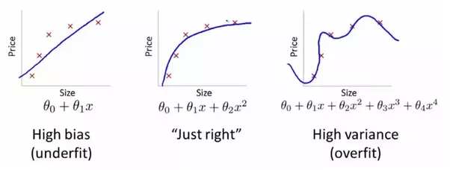
In ML bias refers to a model being systematically wrong. - Econometricians focus on parameters which are systematically wrong or “biased” In ML variance refers to a model changing a lot as a function of a new sample of data.

Slide 15
Intro to Machine Learning
Machine Learning focuses on training models for predictive accuracy.
Good for: “How much will I sell next week?”
Different from OLS’s strength in parameter estimation.
Good for: How much more will I sell if I drop price? How certain am I about that impact; is it statistically significant?

Slide 16
Intro to Machine Learning
Estimates may be systematically “too low” or “too high” (bias) as long as good “out of sample”/”test sample” predictive properties.
Don’t quantify uncertainty the same way. No classical standard errors or confidence intervals
Neither OLS nor ML is “better”- use the right tool for the job!

Slide 17
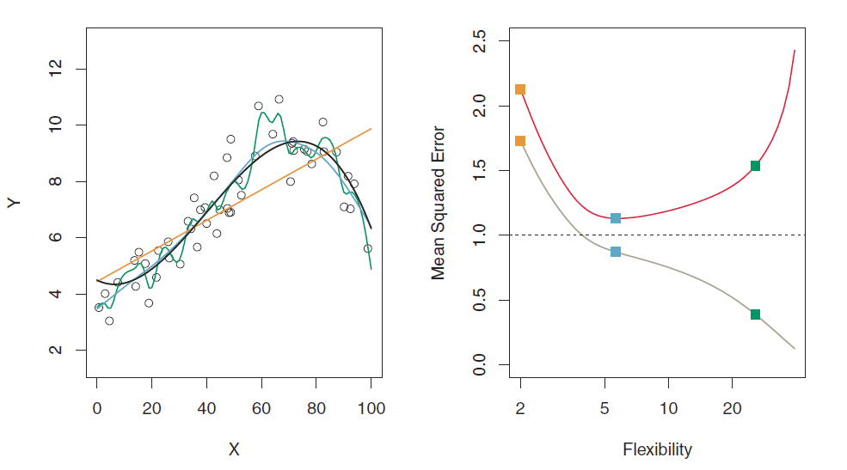
Regularization
Key insight:
How can we algorithmically prevent overfitting like the green line?

Slide 18
Intro to Machine Learning
Idea: what if we make adding additional “stuff” to the model costly?
Same thing as spending $20 at the store
Must carefully evaluate if adding additional features to the model is “worth” it.
What do we mean by “worth it”?

Slide 19
Intro to Machine Learning
Idea: what if we make adding additional “stuff” to the model costly?
Same thing as spending $20 at the store
Must carefully evaluate if adding additional features to the model is “worth” it.
What do we mean by “worth it”? If the model fit improves.

Slide 20
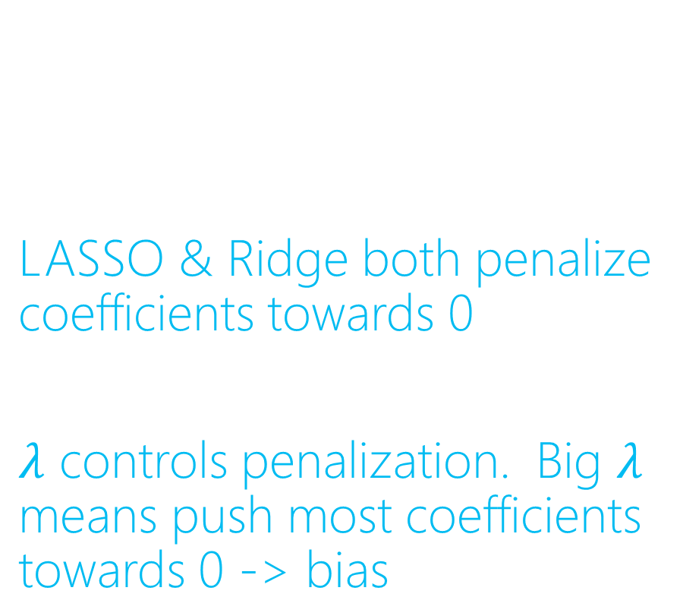
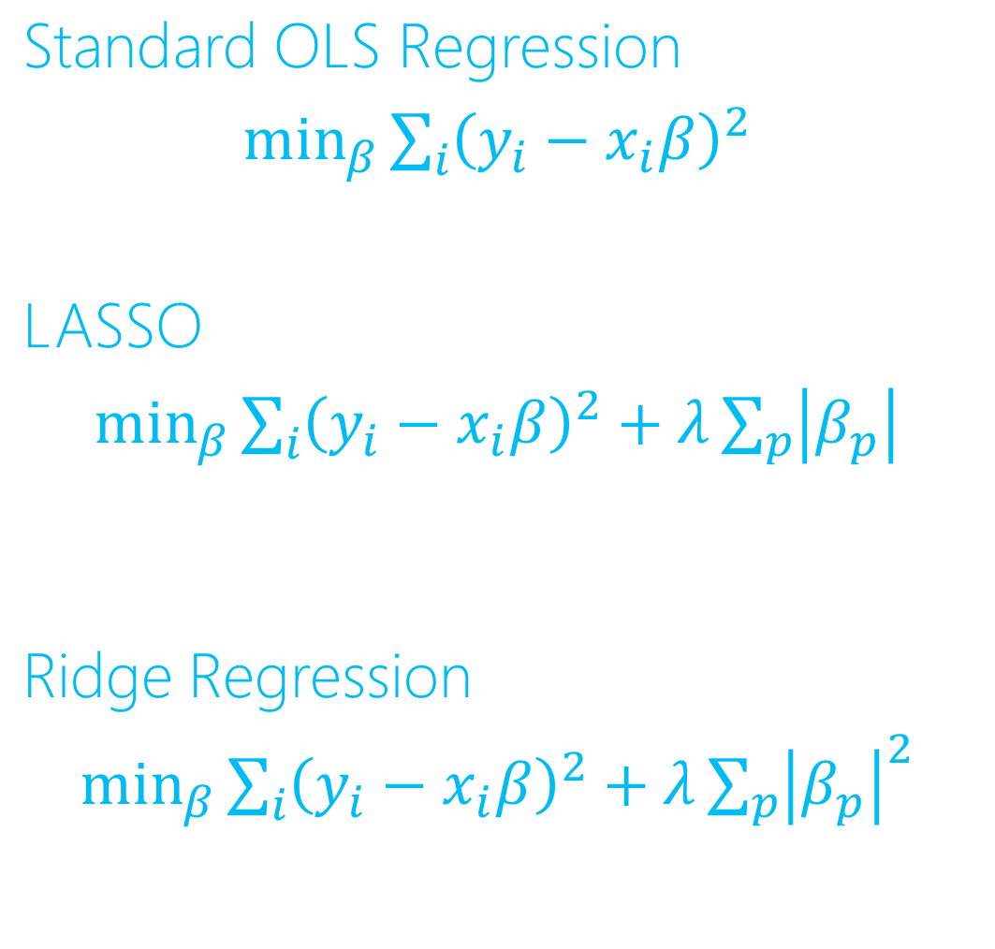
Linear Models: LASSO
Standard OLS Regression
$\min_{β}\sum_{i}{{\left(y_{i}−x_{i}β\right)}^{2}}$
LASSO
$\min_{β}\sum_{i}{{\left(y_{i}−x_{i}β\right)}^{2}}+λ\sum_{p}{\left|β_{p}\right|}$
Ridge Regression
$\min_{β}\sum_{i}{{\left(y_{i}−x_{i}β\right)}^{2}}+λ\sum_{p}{{\left|β_{p}\right|}^{2}}$
LASSO & Ridge both penalize coefficients towards 0
$λ$ controls penalization. Big $λ$ means push most coefficients towards 0 -> bias

Slide 21
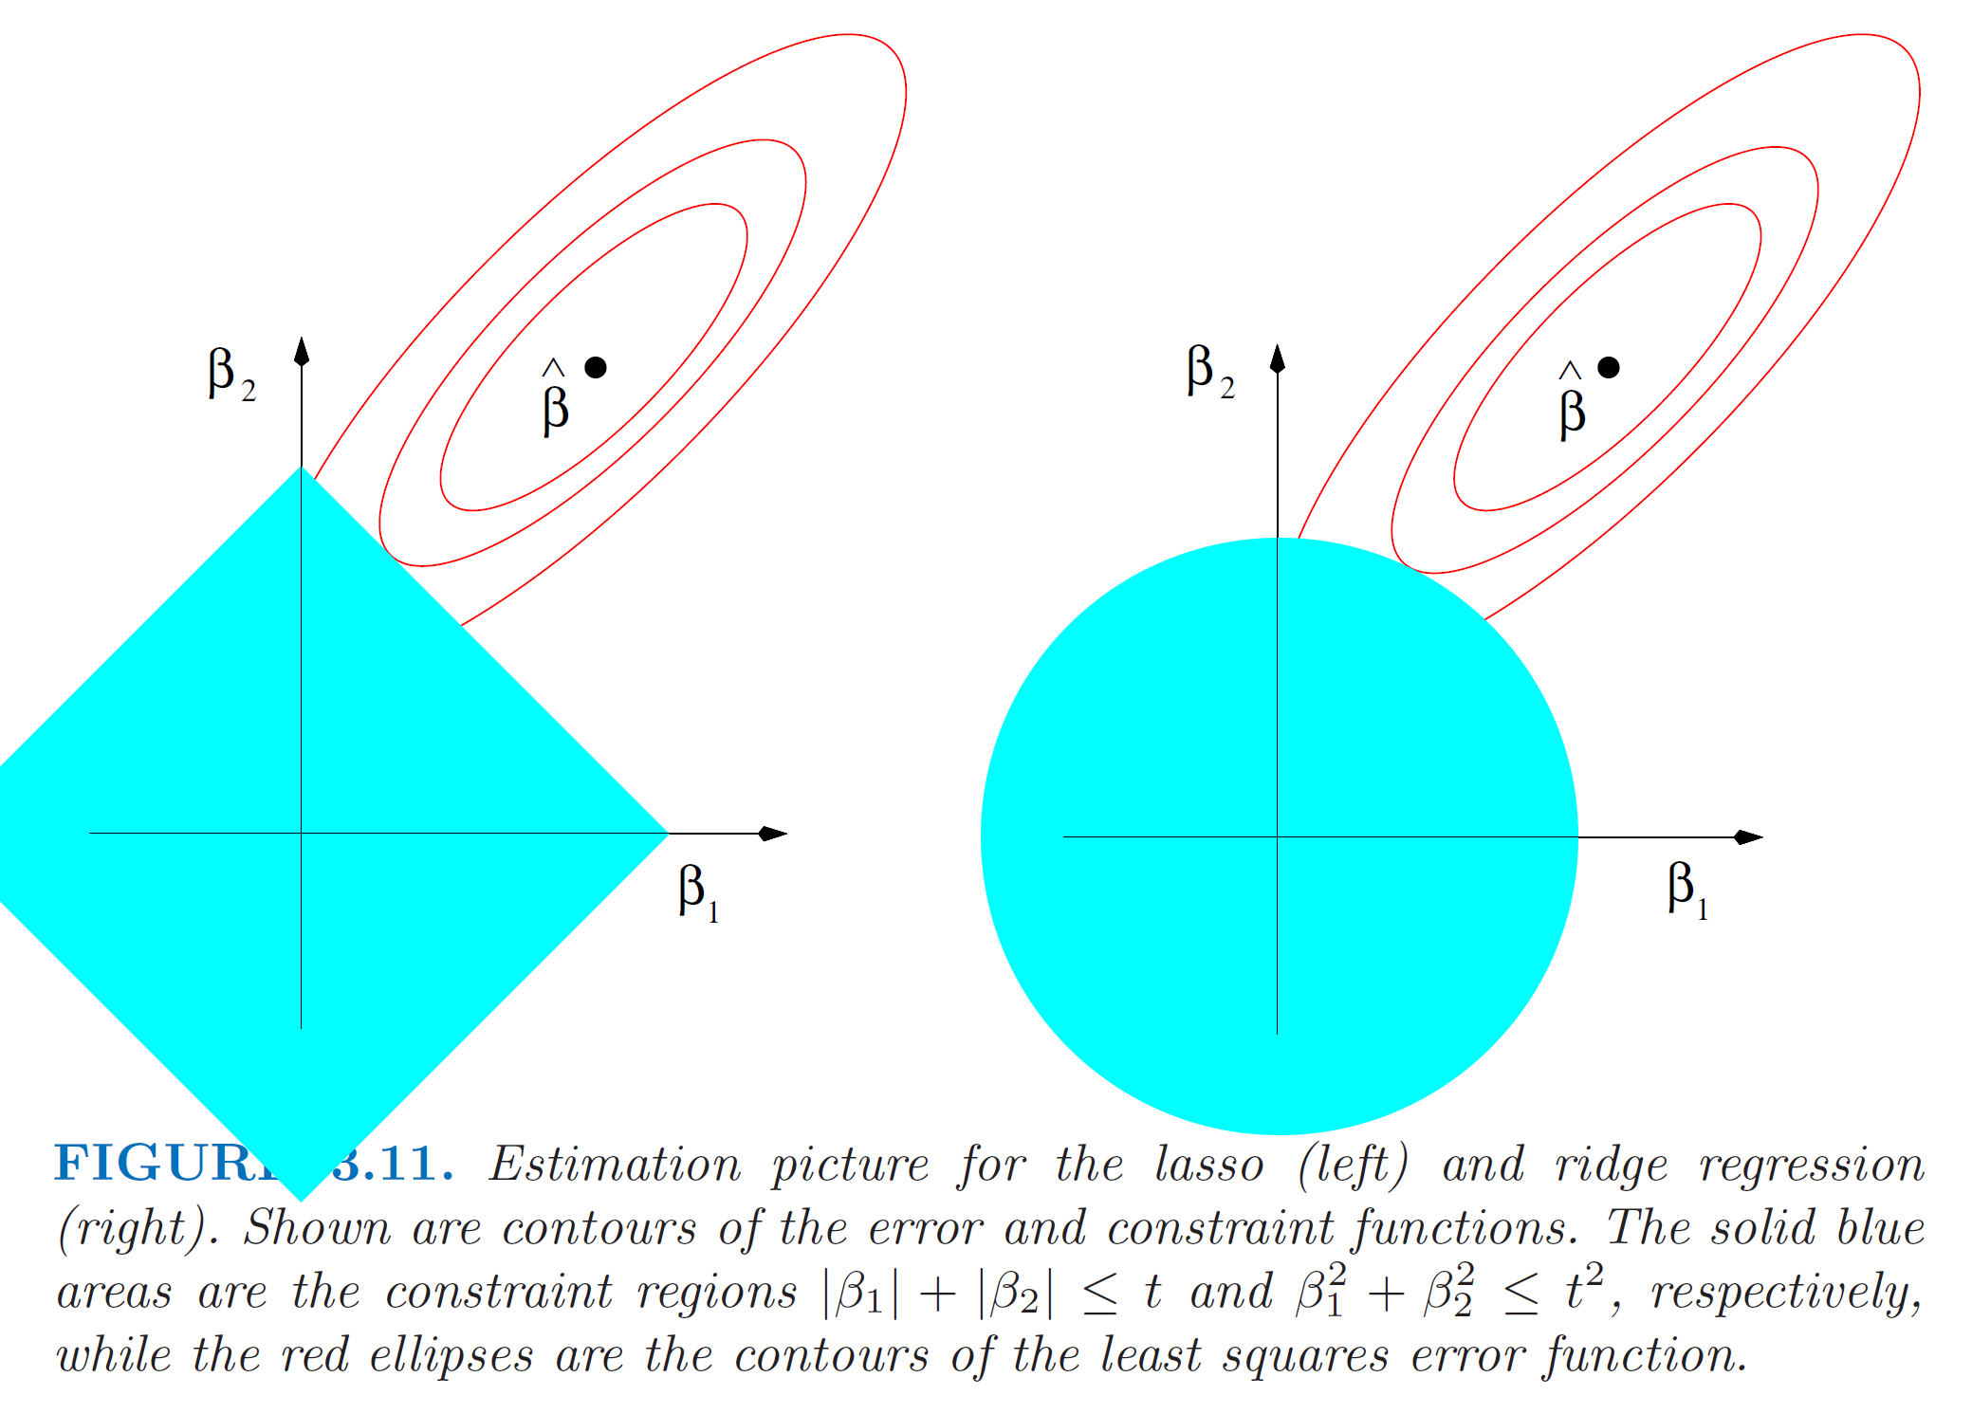
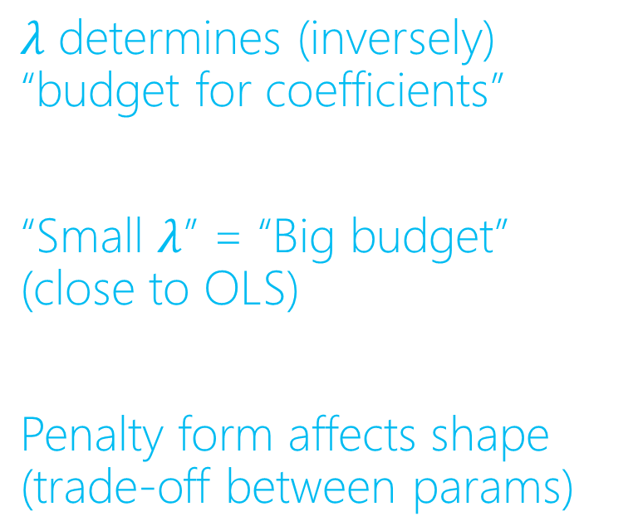
Coefficient Budget and Penalization
LASSO
Ridge
𝜆 determines (inversely) “budget for coefficients”
“Small $λ$” = “Big budget” (close to OLS)
Penalty form affects shape (trade-off between params)

Slide 22
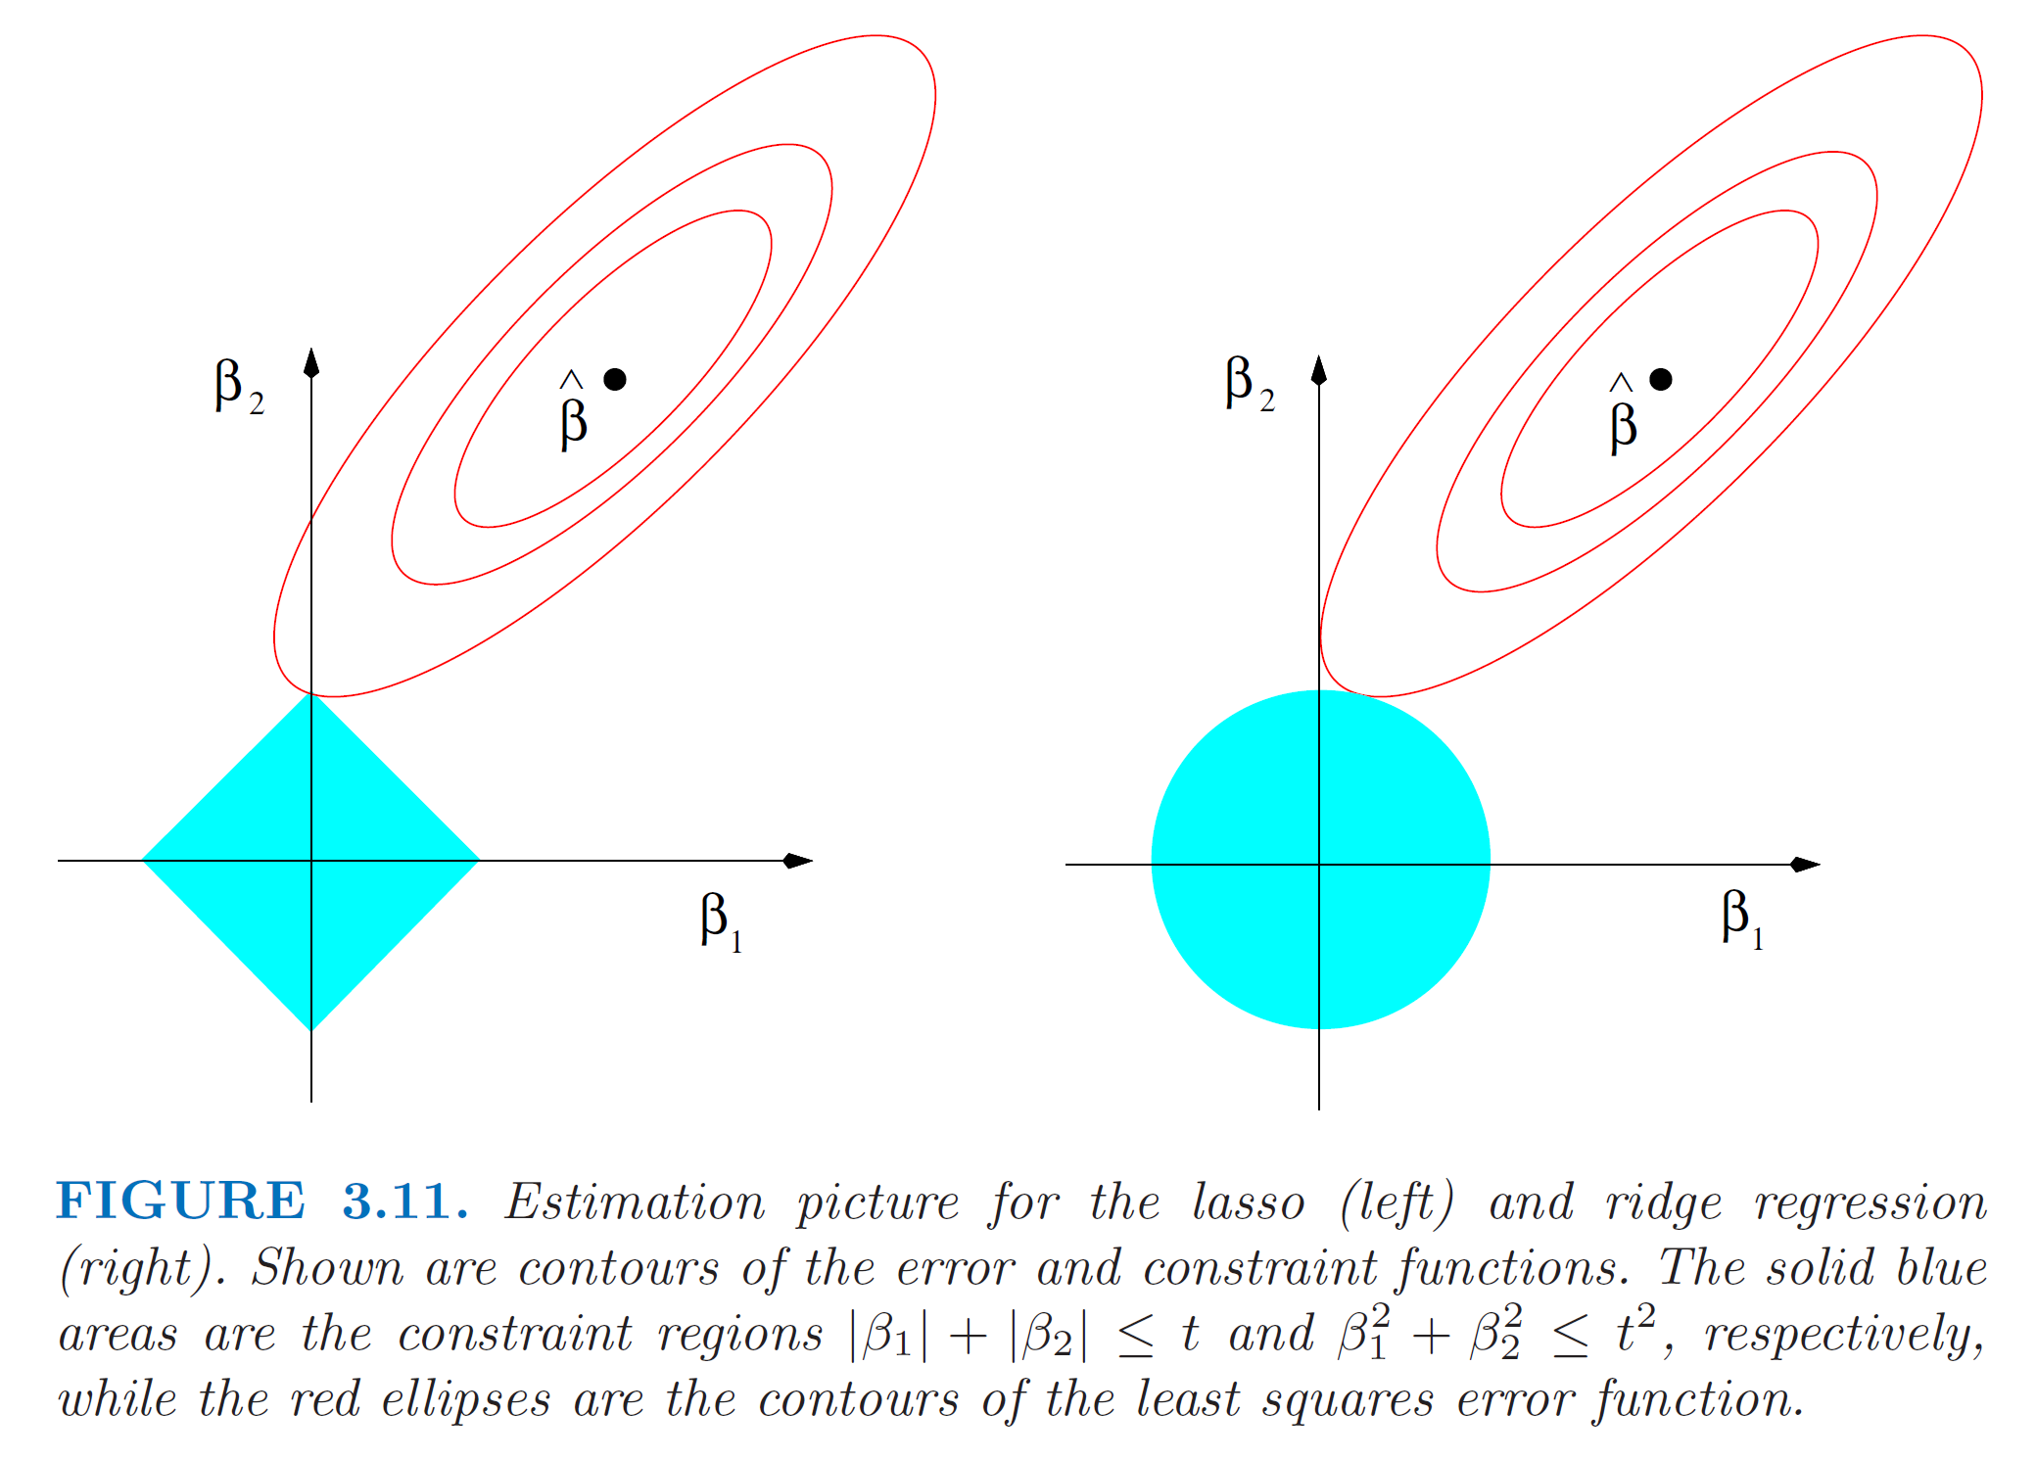
Coefficient Budget and Penalization
Ridge will smoothly make coefficients small
LASSO will push many coefficients to 0 (“model selection”)
LASSO
Ridge

Slide 23
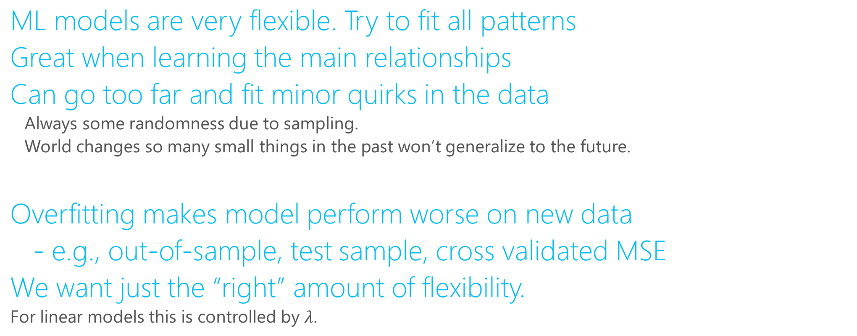
Overfitting
ML models are very flexible. Try to fit all patterns
Great when learning the main relationships
Can go too far and fit minor quirks in the data
Always some randomness due to sampling.
World changes so many small things in the past won’t generalize to the future.
Overfitting makes model perform worse on new data
- e.g., out-of-sample, test sample, cross validated MSE
We want just the “right” amount of flexibility.
For linear models this is controlled by $λ$.

Slide 24
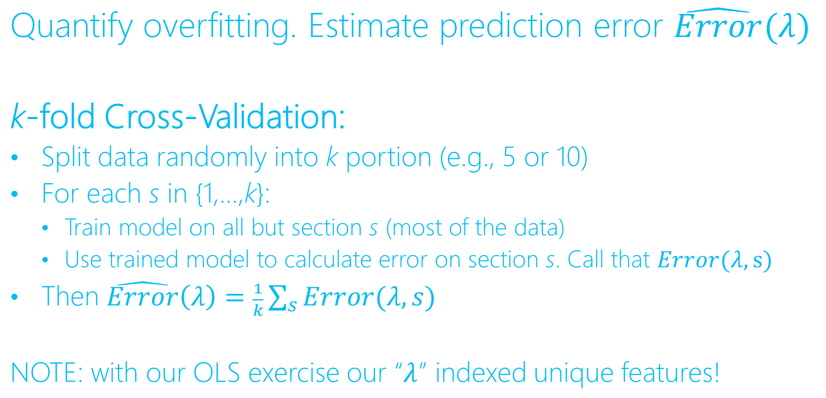
Estimating Prediction Error
Quantify overfitting. Estimate prediction error $\hat{Error}(λ)$
k-fold Cross-Validation:
Split data randomly into k portion (e.g., 5 or 10)
For each s in {1,…,k}:
Train model on all but section s (most of the data)
Use trained model to calculate error on section s. Call that $Error(λ,s)$
Then $\hat{Error}\left(λ\right)=\frac{1}{k}\sum_{s}{Error(λ,s)}$
NOTE: with our OLS exercise our “$λ$” indexed unique features!

Slide 25
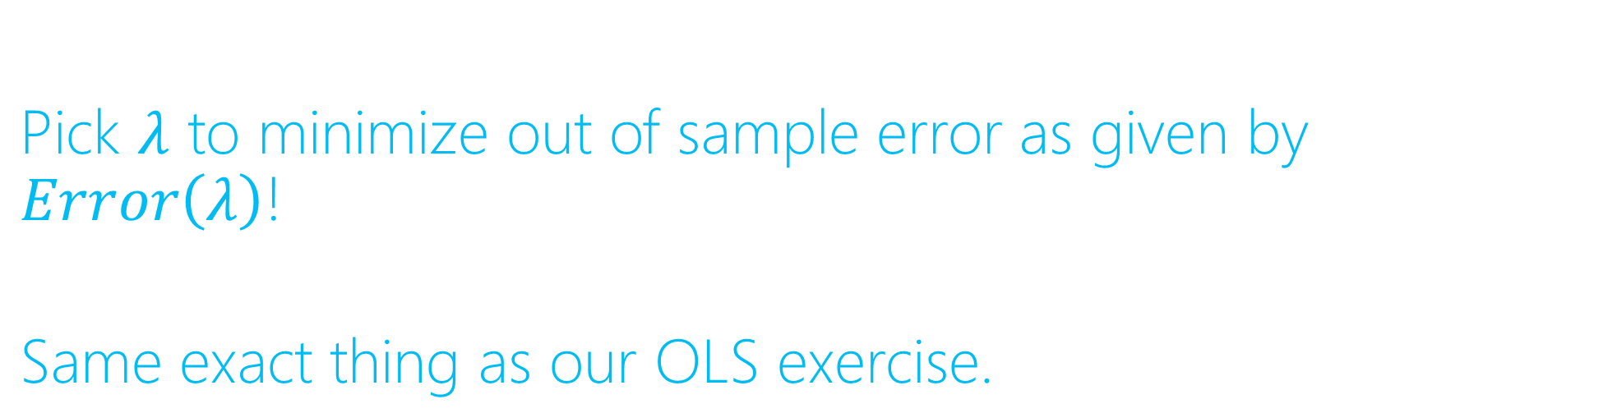
Overfitting Solution
Pick $λ$ to minimize out of sample error as given by $Error\left(λ\right)$!
Same exact thing as our OLS exercise.

Slide 26
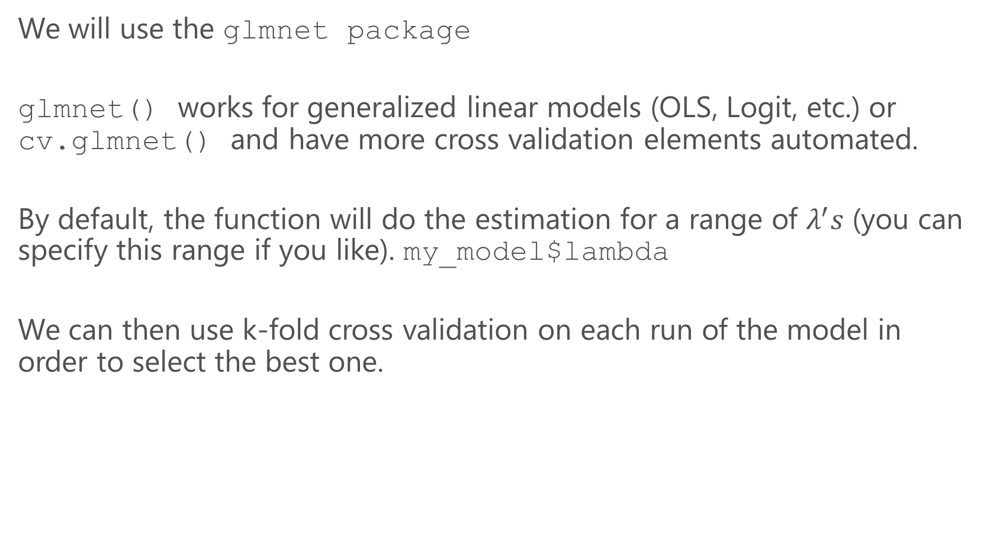
Lasso in R
We will use the glmnet package
glmnet() works for generalized linear models (OLS, Logit, etc.) or cv.glmnet() and have more cross validation elements automated.
By default, the function will do the estimation for a range of $λ^{′}s$ (you can specify this range if you like). my_model$lambda
We can then use k-fold cross validation on each run of the model in order to select the best one.

Slide 27
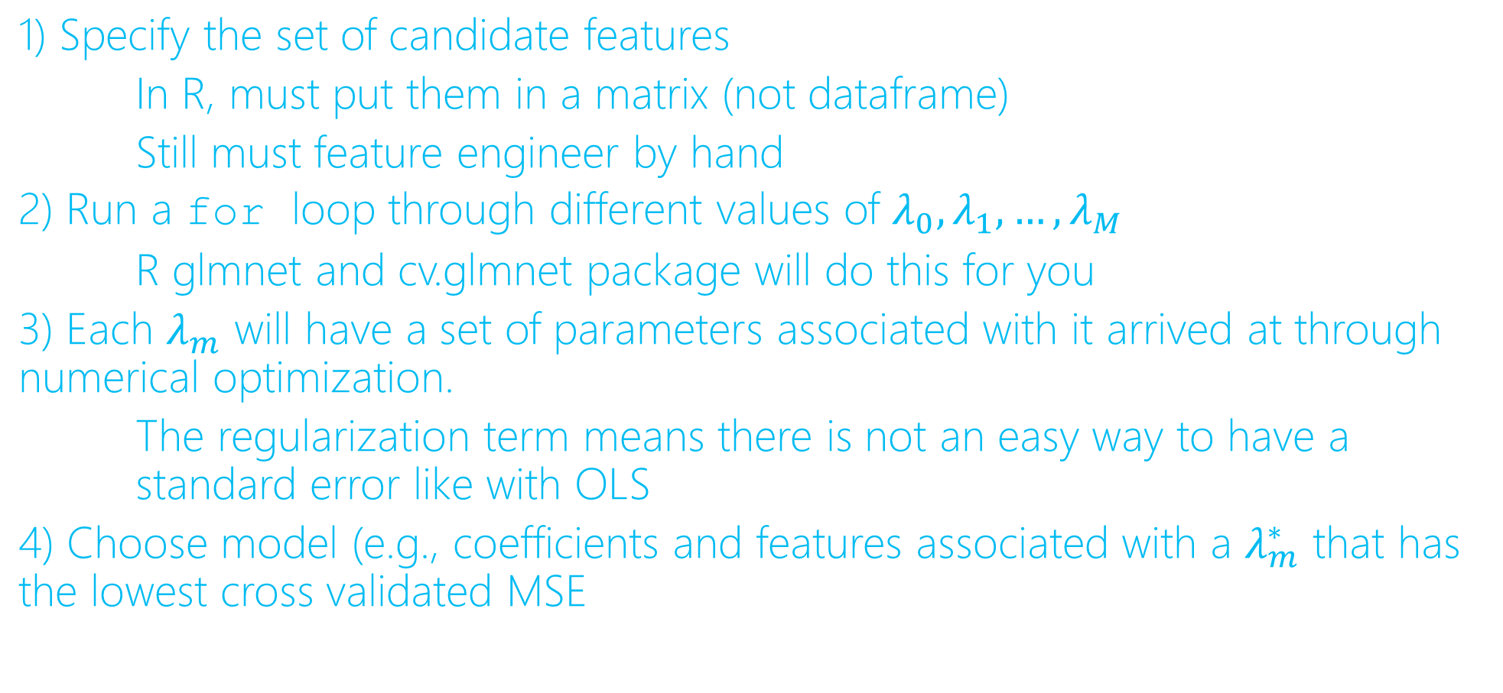
LASSO Algorithm
1) Specify the set of candidate features
In R, must put them in a matrix (not dataframe)
Still must feature engineer by hand
2) Run a for loop through different values of $λ_{0},λ_{1},…,λ_{M}$
R glmnet and cv.glmnet package will do this for you
3) Each $λ_{m}$ will have a set of parameters associated with it arrived at through numerical optimization.
The regularization term means there is not an easy way to have a standard error like with OLS
4) Choose model (e.g., coefficients and features associated with a $λ_{m}^{∗}$ that has the lowest cross validated MSE

